Slide 1
Lecture 11
First-order Circuits (1)
Hung-yi Lee

Slide 2
Dynamic Circuits
Capacitor, Inductor
(Chapter 5)
Time Domain
Frequency Domain
S-Domain
(Chapter 9)
(Chapter 6,7)
(Chapter 11,13)
Abstract

Slide 3
Textbook
First-Order Circuits
  Chapter 5.3, 9.1

Slide 4
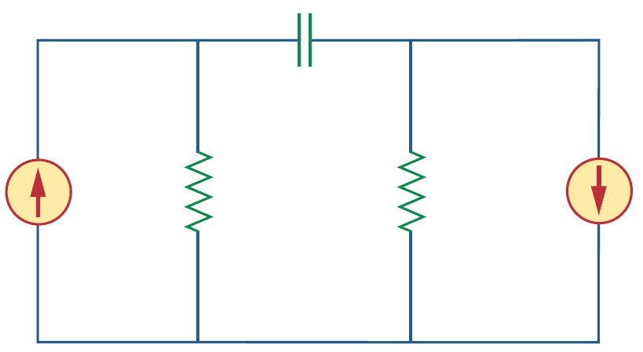
First-Order Circuits
Containing only one capacitor or inductor
The networks excluding capacitor or inductor only contains sources and resistors.
Can always be simplified by Thevenin or Norton Theorem
Notes:
be described using only a first order differential equation

Slide 5
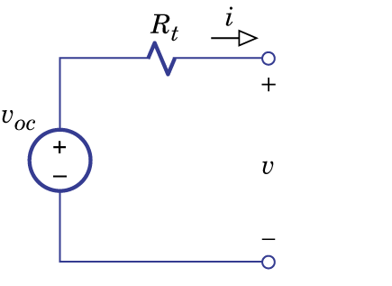
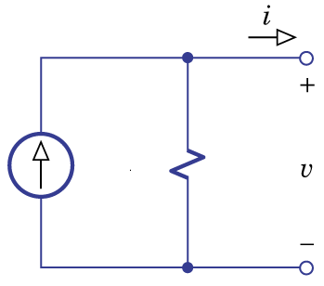
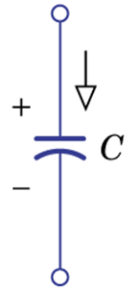
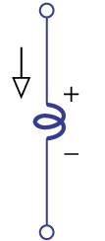
First-Order Circuits
RC:
RL:

Slide 6
First Order Circuits
(this lecture)
v_{oc} and i_{sc} should be dynamic
…
…
…
…
…
Notes:
Switched DC

Slide 7
Unit Step Function
Notes:
Vu(t)

Slide 8
Perspective
Differential Equation
Superposition
State

Slide 9
Perspective 1:
Differential Equation

Slide 10
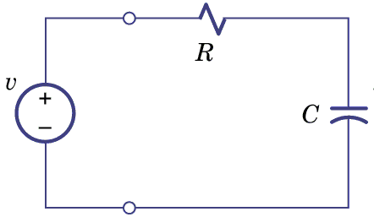
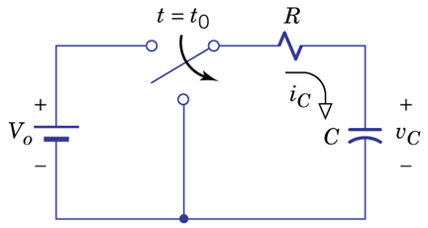
Zero-Input Response - RC
…
Notes:
What is u(-t)???

Slide 11
Zero-Input Response - RC
Find v_{c}(t) and i_{c}(t)
Capacitor is open circuit

Slide 12
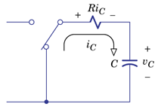
Zero-Input Response - RC
Find v_{c}(t) and i_{c}(t)
Capacitor is open circuit

Slide 13
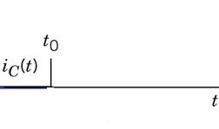
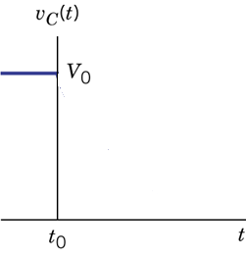
Zero-Input Response - RC
Find v_{c}(t) and i_{c}(t)
?
?

Slide 14
Zero-Input Response - RC
i_{c}(t₀) is unknown
Voltage on the capacitor should be continuous

Slide 15
Zero-Input Response - RC
i_{c}(t₀) is unknown
Assume

Slide 16
Zero-Input Response - RC

Slide 17
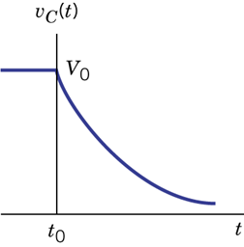
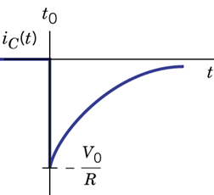
Zero-Input Response - RC
Notes:
Memorize this!

Slide 18
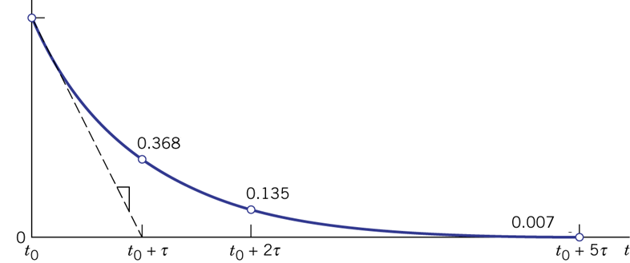
Zero-Input Response - RC
…

Slide 19
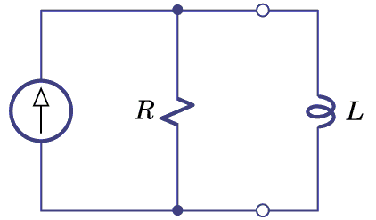
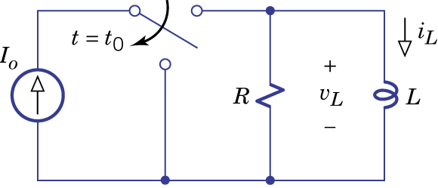
Zero-Input Response - RL
…
Notes:
What is u(-t)???

Slide 20
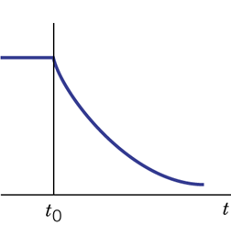
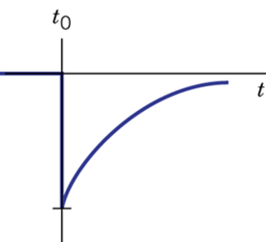
Zero-Input Response - RL
Notes:
Memorize this!

Slide 21
Zero-Input Response
…
Voltage of C,
Current of L
Voltage,
Current
How fast?
Notes:
Memorize this!
How to memorize tau?
What happen if R is negative?

Slide 22
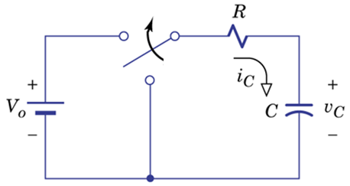
Step Response - RC
…

Slide 23
Step Response - RC
Solved by differential equation

Slide 24
Step Response - RC
v_{N}(t) is general solution
v_{F}(t) is special solution
v_{N}(t) is the solution of
v_{F}(t) is the solution of
Notes:
Natural Response and Forced Response is not mentioned here

Slide 25
Step Response - RC

Slide 26
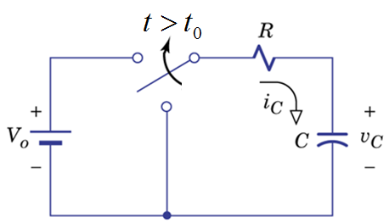
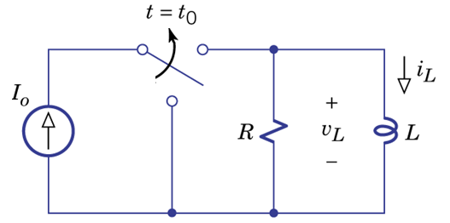
Step Response
…
Voltage of C,
Current of L
Voltage,
Current
How fast?

Slide 27
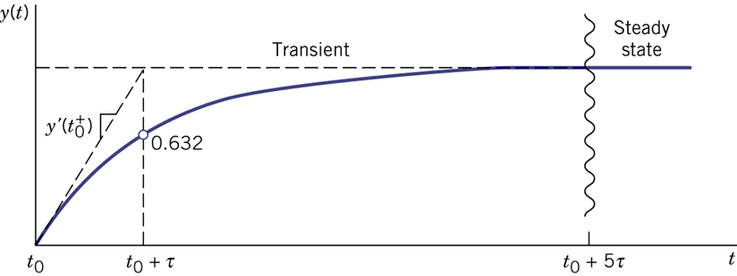
Step Response
…

Slide 28
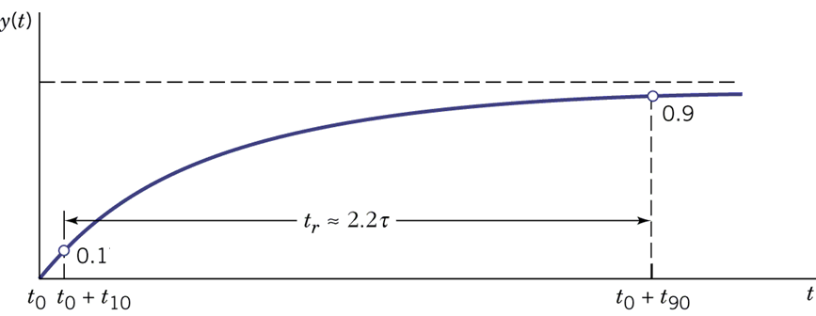
Step Response
…
Rise time
10% time
90% time

Slide 29
Step Response + Initial Condition

Slide 30
Step Response - RC
Notes:
What does it looks like?
Violate superposition

Slide 31
Perspective 2:
Superposition

Slide 32
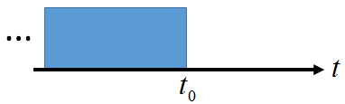
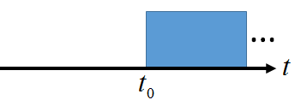
Step Response
Solved by Superposition

Slide 33
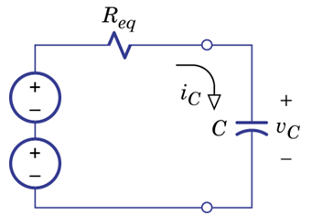
Step Response
…
=
…
…
-
Suppress v₁, find v_{c2}(t)
…
Suppress v₂, find v_{c1}(t)
Notes:
draw

Slide 34
Step Response

Slide 35
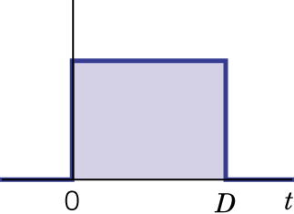
Pulse Response
Solved by Superposition

Slide 36
Pulse Response
=
…
-
…

Slide 37
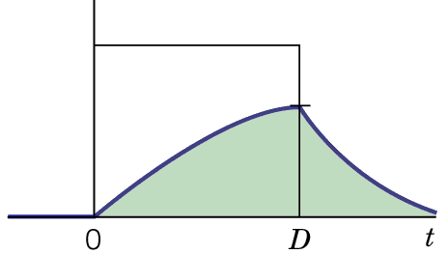
Pulse Response

Slide 38
Pulse Response
(If x is small)
If
Notes:
Important in the next slide

Slide 39
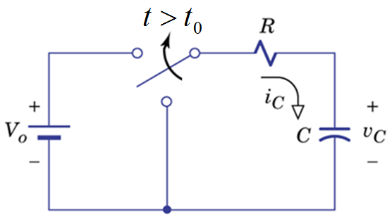
Step Response + Initial Condition
Violate Superposition?

Slide 40
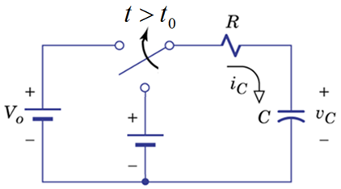
Step Response + Initial Condition
The initial condition is automatically fulfilled.
Do not have to consider the initial condition anymore

Slide 41
Step Response + Initial Condition
Zero-Input Response!
Step Response
(without initial condition)!

Slide 42
Step Response + Initial Condition
Differential
Equation
Superposition
General
solution
Special solution
Zero-input Response
Step Response
The initial condition is considered in the general solution term.
The initial condition is automatically fulfilled.

Slide 43
Perspective 3:
State

Slide 44
State
The capacitor voltages and inductor currents constitute the state variables of any circuit. (P410)
If the circuit does not have any capacitor or inductor
The currents or voltages at time t do not depend on their values not at t.
Why?
Notes:
Meta
State incorporates all information about the past to predict the future
V(t) does not depend on i(t-1)

Slide 45
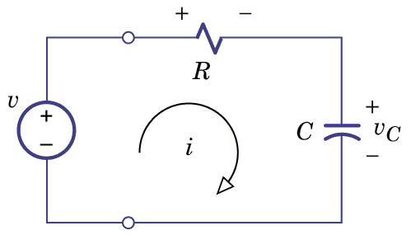
State
The capacitor voltages and inductor currents constitute the state variables of any circuit. (P410)
With capacitor or inductor
You can not explain the current or voltage at present unless considering the past.

Slide 46
State
The capacitor voltages and inductor currents constitute the state variables of any circuit. (P410)
……
If we know the voltage before at t₀
We do not care about the current before t₀
Capacitor voltages are States

Slide 47
State
The capacitor voltages and inductor currents constitute the state variables of any circuit. (P410)
State at t₀
Source after t₀

Slide 48
State
The capacitor voltages and inductor currents constitute the state variables of any circuit. (P410)
The response after t₀
From state at t₀
(Ignore input)
From Input after t₀
(Ignore state)
Notes:
Meta

Slide 49
Response
y(t): voltage of capacitor or current of inductor
y(t) = general solution + special solution
=
=
= natural response + forced response
= state response (zero input)
+ input response (zero state)

Slide 50
Zero-Input Response
…
Ignore everything before t₀
Considering the circuit from t₀:
State: v_{c}(t₀)=V₀
Lead to
No input after t₀

Slide 51
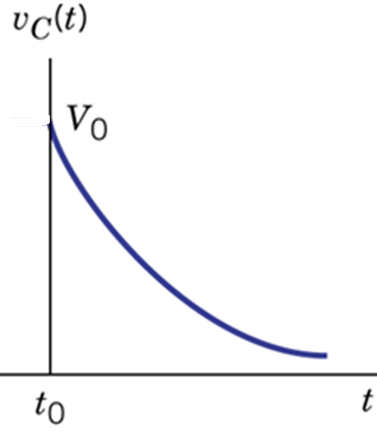
Zero-Input Response
State: v_{c}(t₀)=V₀

Slide 52
Zero-Input Response
…
Considering the circuit from t₀-D:
State: v_{c}(t₀-D)=V₀
Input after t₀-D

Slide 53
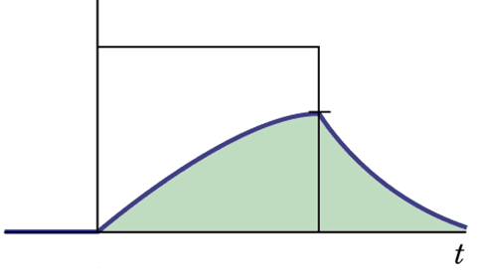
Zero-Input Response
State: v_{c}(t₀-D)=V₀
Input after t₀-D

Slide 54
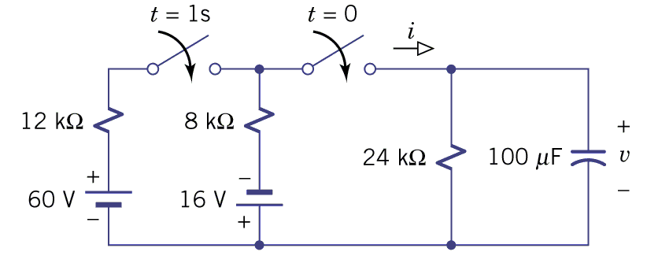
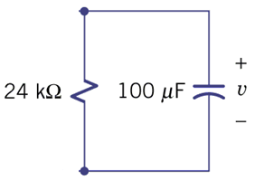
Example 9.4
Notes:
Draw on the broad to compute voc
1. Suppress 60 V: 12||24=12X24/(12+24)=8 => -8V
2. Suppress 16V: 8X24/(8+24)=6 => 20V
All: 12V

Slide 55
Example 9.4

Slide 56
Example 9.4
State response:
No state response
Input response:
Notes:
Tau = 6k X 100mu F = 0.6
V(1-)= …… -9.73

Slide 57
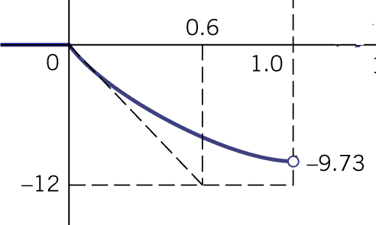
Example 9.4
State response is zero

Slide 58
Example 9.4
State response:
Input response:
Notes:
What are V0, Vx, to and tau?

Slide 59
Example 9.4
State response:
Input response:

Slide 60
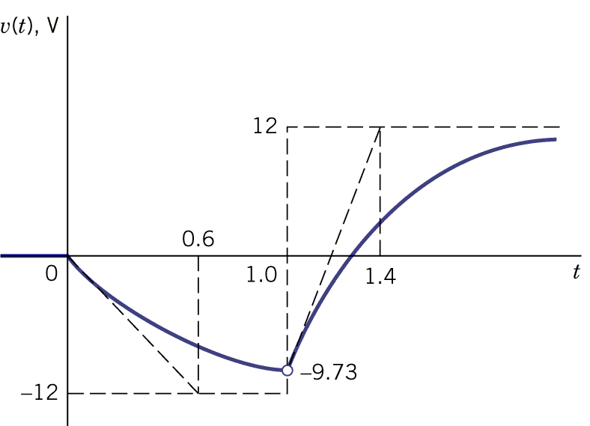
Example 9.4

Slide 61

Application:
Touchscreen

Slide 62
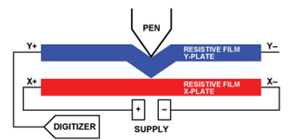
Resistive Touchscreen
電阻式觸控螢幕
http://www.analog.com/library/analogdialogue/archives/44-02/touch_screen.html
Notes:
https://www.sparkfun.com/datasheets/LCD/HOW%20DOES%20IT%20WORK.pdf
Press, therefore touch, but how to detect the position
Draw
Change direction

Slide 63


Capacitive Touchscreen
電容式觸控螢幕
Before Touching
Finger is Touching
http://www.eettaiwan.com/ART_8800583600_480702_TA_bc13e6c4.HTM
Notes:
http://maciku.blogspot.com/2010/11/iphone.html
http://www.mem.com.tw/article_content.asp?sn=0902060012
network, 寄生電容
Draw a simple one, Pick one line
What happen with finger
Capacitance change, larger or smaller
Pulse respose
Tau is larger or smaller

Slide 64
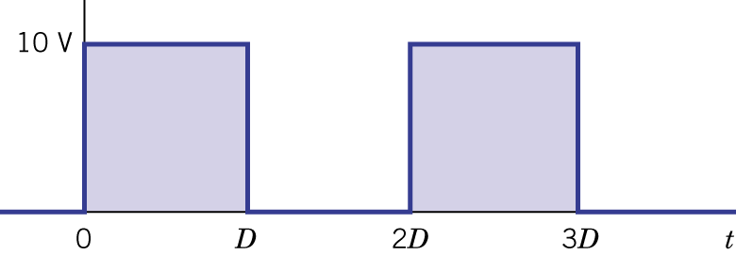
Homework
9.14
9.16

Slide 65
Homework - Stability
The first-order circuit shown below is at steady state before the switch closes at t=0. This circuit contains a dependent source and so may be unstable. Find the capacitor voltage, v(t), for t>0.
Notes:
Dorf P349
Tau is negative

Slide 66
Homework - Stability
The gain of the dependent source below is B. What restrictions must be placed on the gain to ensure that the circuit is stable? Design this circuit to have a time constant of +20ms.
Notes:
Dorf P349

Slide 67
Thank you!

Slide 68
Homework
9.14
9.16

Slide 69
Stability
The first-order circuit shown below is at steady state before the switch closes at t=0. This circuit contains a dependent source and so may be unstable. Find the capacitor voltage, v(t), for t>0.
Notes:
Dorf P349

Slide 70
Stability
The gain of the dependent source below is B. What restrictions must be placed on the gain to ensure that the circuit is stable? Design this circuit to have a time constant of +20ms.
Notes:
Dorf P349

Slide 71
Acknowledgement
  感謝 莊佾霖(b02)
  指出投影片中 Equation 的錯誤

